Slide 1
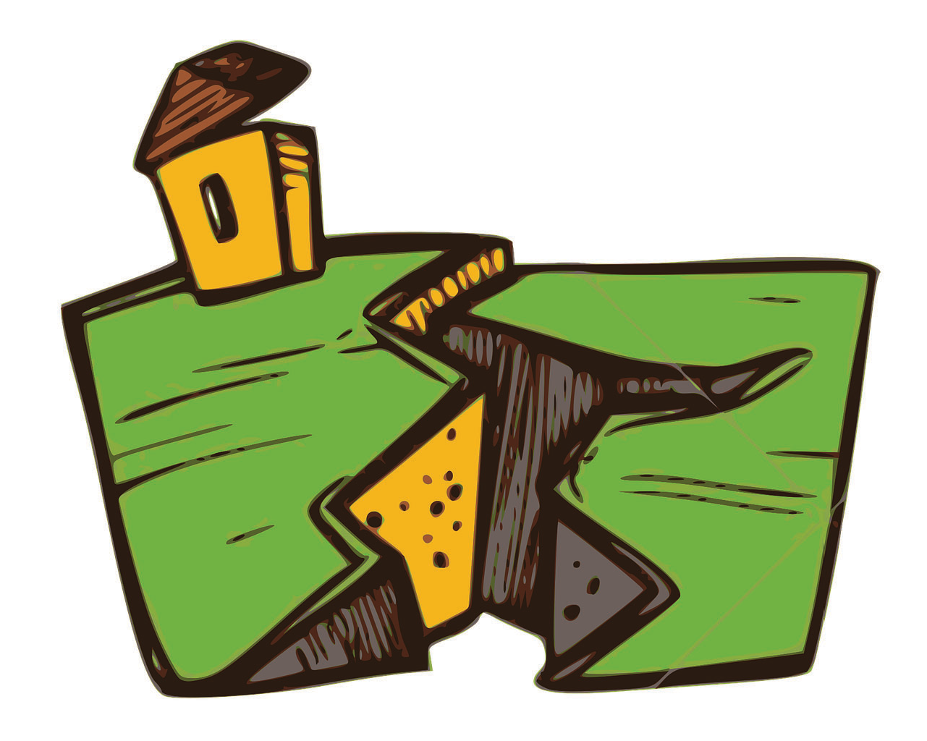
4
Lesson Four:
Earthquakes
Key Points:
What Is an Earthquake?
Fault Lines
Waves
Measuring Earthquakes
Earthquake Effects & Preparedness
49

Slide 2
SUPPLIES AND PREPARATION
Sandpaper Plates
Slinky Waves
Activity Supplies:
Activity Supplies:
•
•
Seismograph
Activity Supplies:
Clear jar
Spaghetti Energy
Activity Supplies:
Gingerbread Earthquake
Dirt
Activity Supplies:
Rocks,
50

Slide 3
4
Lesson
Earthquake Engineering
Activity Supplies for Each Child:
Clear cup
Nature Journal
Give students nature journal page prior to lesson & review at start of lesson.
Scan QR code for supplies & instructions
51

Slide 4
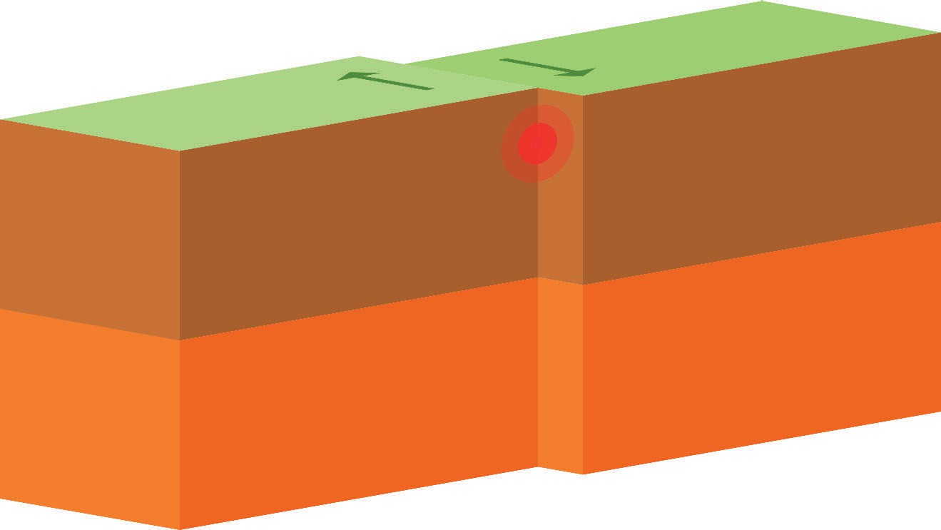
What is An Earthquake?
An earthquake is a sudden shaking of the Earth’s surface caused by the release of energy stored in the Earth’s crust.
The Earth’s tectonic plates are always moving.
When they push against each other, they sometimes get stuck.
When they finally break free, the energy released causes the ground to shake.
Earthquake Faults with Sandpaper:
Tape a sandpaper belt to the table with a piece of folded cardstock (or “bump”) on it. Pull a block with sandpaper along the belt using a rubber band. When the block hits the bump, it will stop. When it frees, it will release lots of energy shoot off.
52

Slide 5
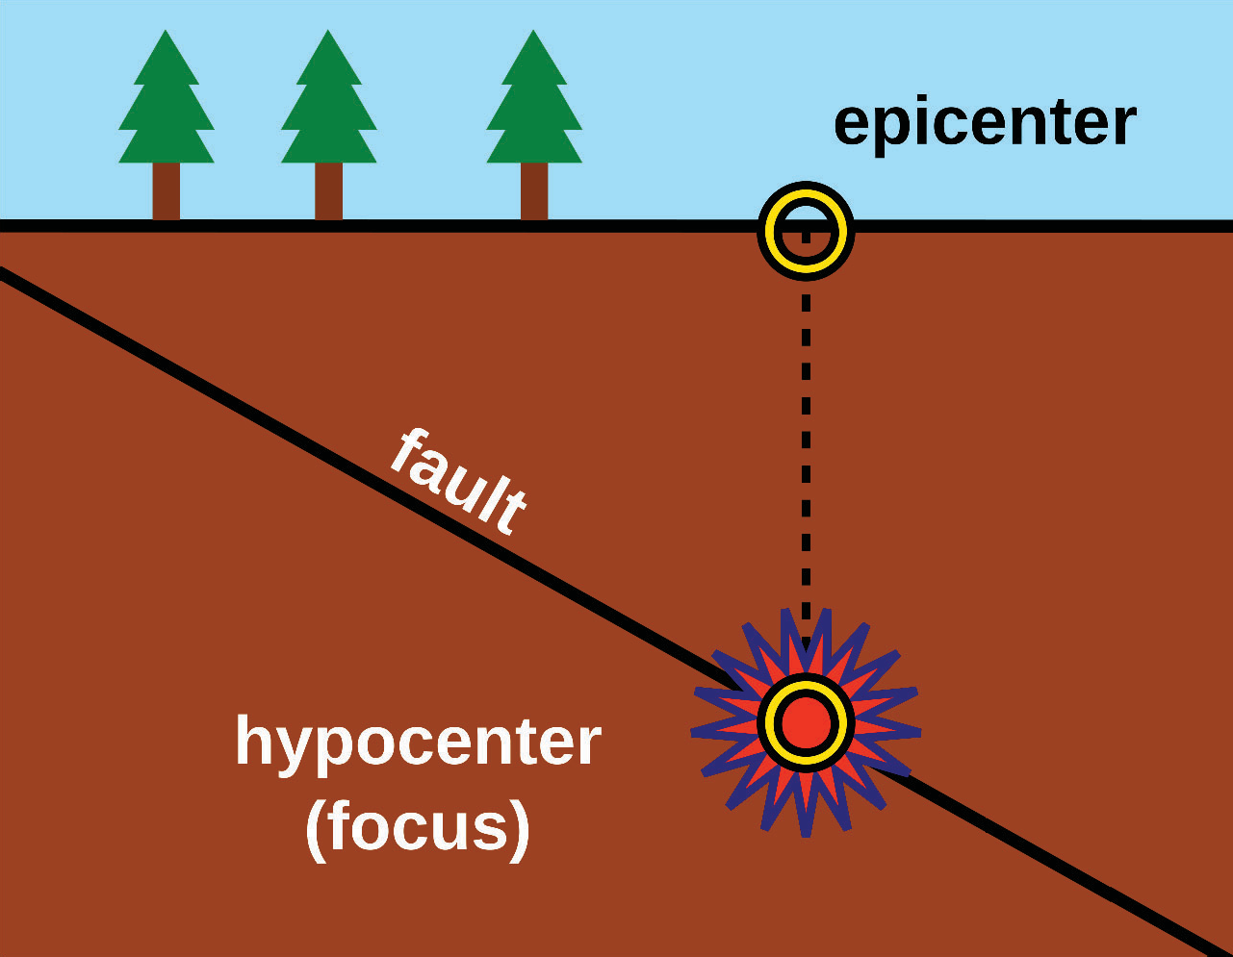
Important Terms
Do you know what the following terms mean?
Aftershock
Following the main earthquake, there can be additional smaller earthquakes, sometimes even for months.
Focus or Hypocenter
The actual location wihin the Earth where the earthquake starts.
Epicenter
The point on the Earth’s surface directly above the focus (where the rupture begins)
Foreshock
A smaller earthquakes before the main earthquake.
53

Slide 6
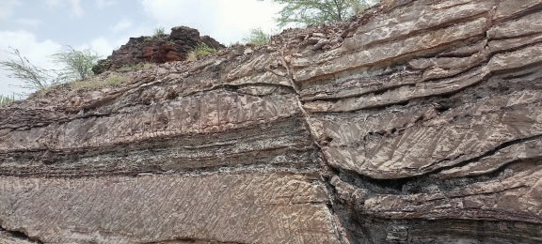
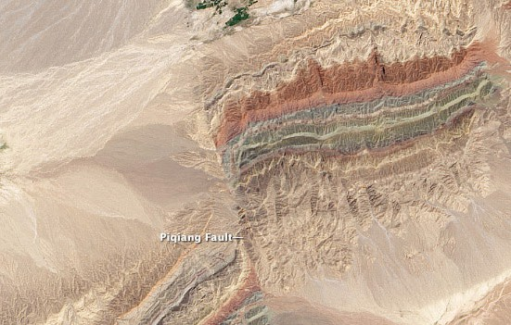
4
Lesson
Fault Lines
Earthquakes usually happen along fault lines.
A fault line is a long crack within the Earth’s crust.
Fault lines usually occur at plate boundaries (where two tectonic plates meet & there is significant change in speed or direction of one plate relative to the other).
Other type of fault lines include:
Intraplate Faults: Located within a tectonic plate.
Ancient Faults: Remnants of ancient plate boundaries that are no longer active.
Human-Induced Faults: Produced by human activities, such as mining, fracking & filling large reservoirs.
54

Slide 7
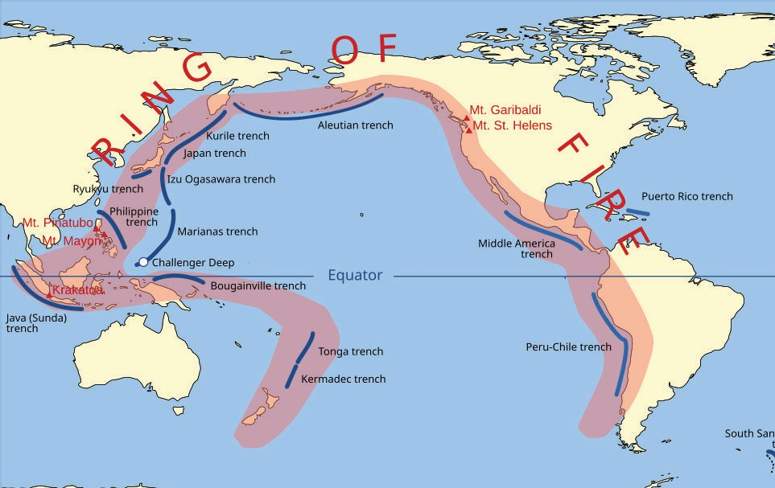
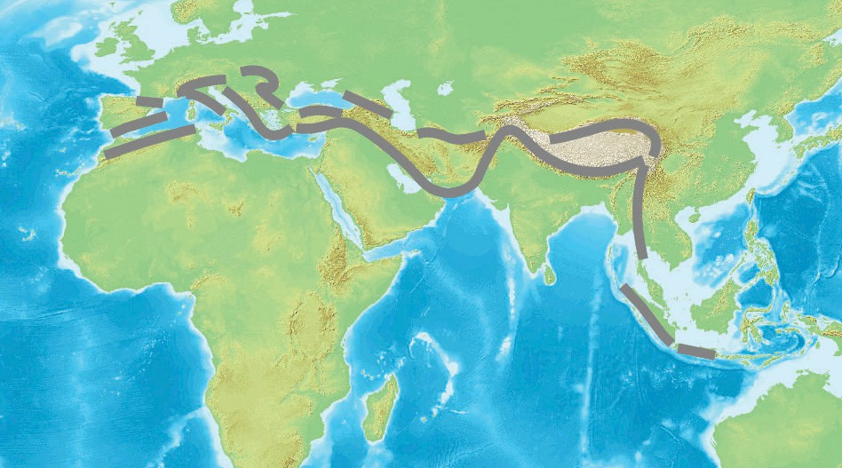
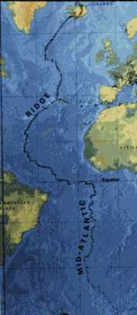
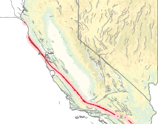
4
Major Fault Areas
Lesson
Ring of Fire
The Alpide Belt
Experiences 81% of the world’s largest earthquakes
Experiences 17% of the world’s largest earthquakes; some very destructive
Mid-Atlantic Ridge
San Andreas Fault
Largest fault line in the United States
Third most prominent belt. Mostly far away from human development, except Iceland.
55

Slide 8
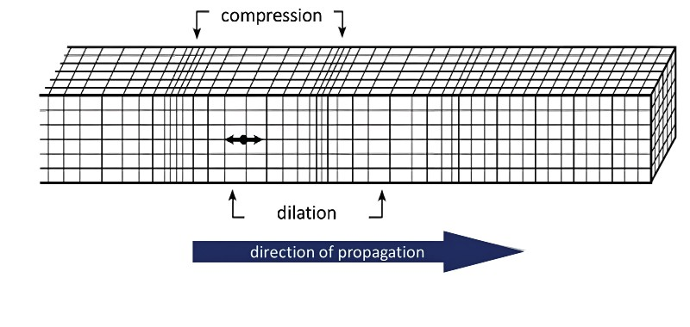
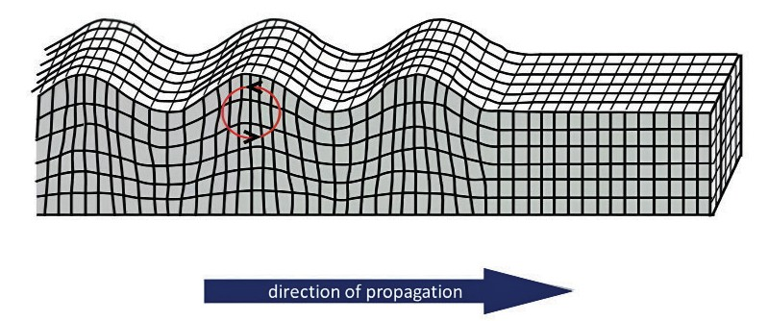
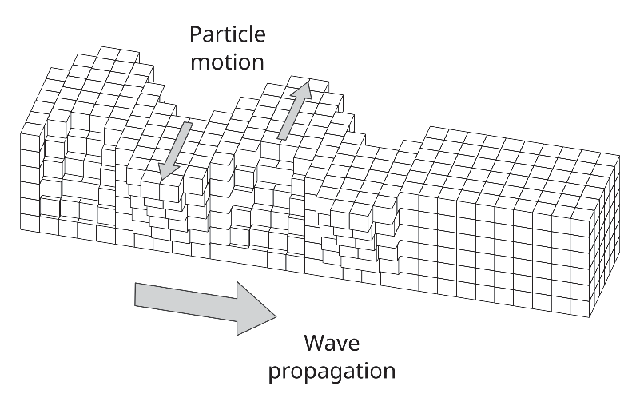
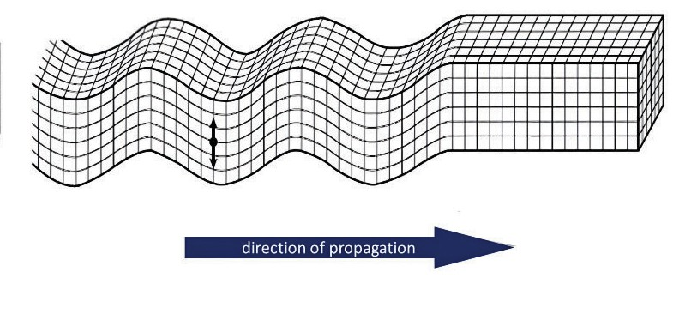
4
Earthquake Waves
There are four main types of earthquake waves, divided into two categories.
Lesson
Body Waves
Travel through the Earth’s interior
Primary (P) Waves
Waves push & pull the ground in the same direction the wave is moving (compressional)
Fastest waves (3-5 miles/second)
Can travel through solids, liquids & gases
Secondary (S) Waves
Surface Waves
Travel along the Earth’s surface
Rayleigh Waves
Cause a rolling, circular motion.
Slowest waves (about 1.5 miles/second)
More destructive than body waves.
Love Waves
Waves move the ground up & down, or side to side •
The ground moves perpendicular to the direction of the wave
Slower than body waves
Most destructive waves
(shear waves)
Slower than P-waves (2-2.5 miles/second)
Can only travel through solids (not liquids or gas)
Slinky Waves
Show each type of wave using a slinky & rope.
56

Slide 9
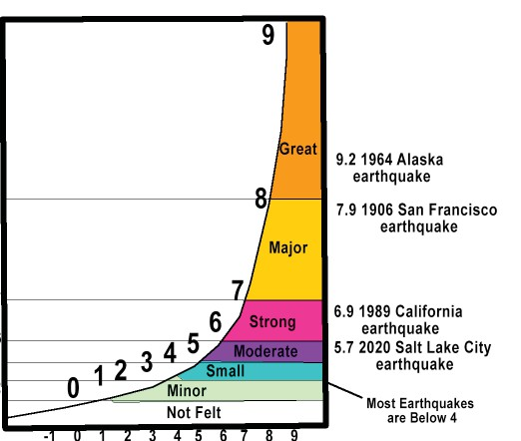
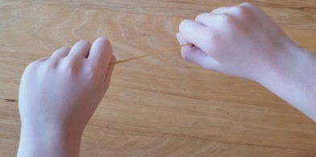
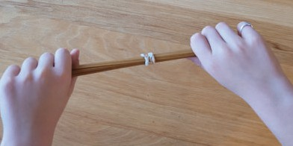
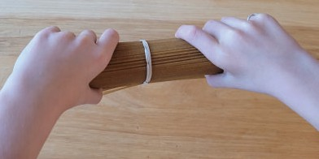
Measuring Earthquakes
There are several ways to measure earthquakes.
4
Lesson
Magnitude
Magnitude measures the size of the
earthquake at its source & the total amount of energy it releases.
Each whole number on the scale represents an increase in wave motion by a factor of 10 and 32 times more energy being released.
The Richter scale was used, but now we use the Moment Magnitude Scale (Mw).
Released Energy:
Use pasta to show the amount of energy released by an earthquake. If a magnitude 1 earthquake released enough energy to break 1 noodle, then a magnitude 2 would break 32 noodles & a magnitude 3 would release enough energy to break 1024 noodles. Try breaking each group of noodles.
Magnitude: 1
Energy released: 1 noodle
Magnitude: 2
Energy released: 32 noodles
Magnitude: 3
Energy released: 1024 noodles
57

Slide 10
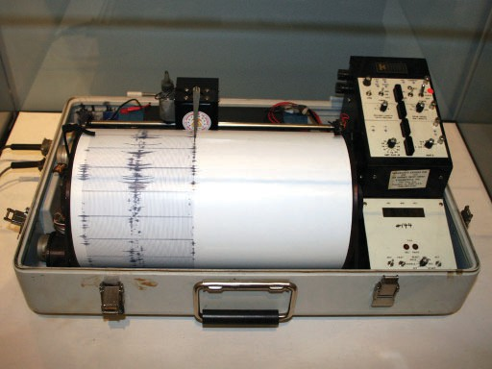
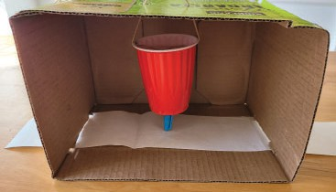
4
Lesson
Measuring Earthquakes Cont.
Seismographs
Scientists use a special tool called a seismograph to detect & measure earthquakes. Theses machines record the shaking of the ground during an earthquake. It sahows the arrival times of P-waves & S-waves, which helps determine the earthquake’s epicenter.
Seismograph:
Build a seismograph using a box. Shake the box as you pull the paper through & see what happens to the waves.
Intensity
In addition to measuring magnitude, scientists also measure the effects or severity of an earthquake based on the damaged observed.
58

Slide 11
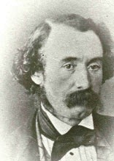
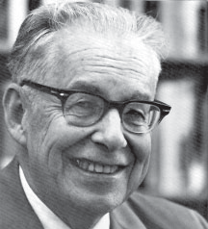
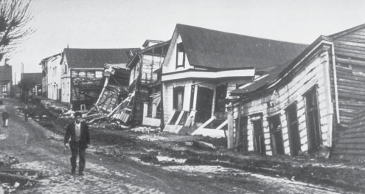
Seismology
In 1750, England was rocked by a series of 5 strong eqarthquakes. This was followed by tsunami that killed around 70,000 people in Lisbon, Portugal. This prompted studying earthquakes in more depth & marked the modern era of seismology
Robert Mallet
1810-1881
An Irishman; often considered the father of seismology.
Charles Richter
1900-1985
Created the Richter magnitude scale, which was used until 1979 to measure earthquakes.
World Record
The strongest earthquake ever recorded occured in Valdivia, Chile in 1960. It had a magnitude of
9.6 and lasted ten minutes. resulting tsunamis affected Hawaii, Japan, the Philippines, New
Zealand & Australia.
59

